Slide 1

Team No: 9
Early detection of Cognitive decline
S.NO | Reg. No. | Name of the student
1 | BL.EN.U4CSE22032 | LOHITH KANDIBANDA
2 | BL.EN.U4CSE22031 | YASWANTH KANCHARLA
3 | BL.EN.U4AIE22109 | HARI SANKAR CH
4 | BL.EN.U4AIE23041 | G MOKSHITH TEJA
5 | BL.EN.U4AIE23014 | K MANI VIGNESH

Slide 2
Problem Statement
Designing and developing a machine learning or deep learning model that analyses eye gaze patterns, including saccades, fixations, and pupil dilation, to detect early signs of Alzheimer’s Disease (AD) or ALS-related cognitive decline.

Slide 3
Abstract
Early diagnosis of neurodegenerative diseases such as Amyotrophic Lateral Sclerosis (ALS) and Alzheimer’s Disease (AD) is crucial for improving treatment outcomes and slowing cognitive decline. This project presents a novel machine learning-based system that leverages eye-tracking data to detect early cognitive impairment indicative of ALS or AD. By analysing key ocular biomarkers such as saccades, fixations, and gaze stability patterns, the system extracts relevant features including session duration, valid gaze points, saccade count, and mean fixation duration. A tuned Multi-Layer Perceptron (MLP) model is trained on a balanced and pre-processed dataset using eye-tracking recordings, achieving reliable classification between healthy individuals and those at potential risk. Furthermore, a real-time webcam-based module is integrated using Mediapipe to simulate gaze behavior and predict health status live. This work demonstrates that low-cost, non-invasive eye tracking combined with intelligent learning systems can support early screening of ALS/AD and enable accessible cognitive monitoring tools.

Slide 4
Introduction
Neurodegenerative diseases such as ALS and Alzheimer’s Disease present significant diagnostic challenges, especially during early stages when symptoms are subtle or overlap with normal aging. Conventional clinical assessments are often invasive, time-consuming, or dependent on expensive imaging equipment. In contrast, human eye movements provide a promising, non-invasive window into neurological health. Research suggests that changes in gaze behavior—such as erratic saccades, prolonged fixations, or inconsistent gaze points—may reflect underlying cognitive impairments linked to ALS and AD.
Our project aims to build an intelligent system that leverages eye-tracking data to detect such early warning signs. Using a dataset of ET.csv files collected from ALS and healthy subjects, we extract temporal and spatial features from gaze coordinates. These include metrics like session duration, number of valid gaze points, frequency of saccades (rapid eye movements), and average fixation durations. The extracted data is preprocessed, scaled, and balanced to address class imbalance, followed by training a neural network model. Additionally, the system supports real-time webcam-based scanning using Mediapipe’s face mesh technology, enabling eye-tracking-based health prediction even without specialized hardware.
Through this approach, we explore the viability of combining low-cost eye tracking with machine learning to provide accessible cognitive health monitoring and early screening tools for at-risk populations.

Slide 5
Dataset Description
Dataset Description
Dataset Name: EEGET-ALS (Eye-Tracking Dataset for ALS Detection)
Domain: Biomedical / Cognitive Neuroscience
Purpose: Identify cognitive decline patterns using eye-tracking data from ALS and Healthy individuals.
Organized by participant ID (ALS or Healthy) → recorded session time → scenarios
Each scenario contains an `ET.csv` file with gaze data
Hierarchy:
EEGET-ALS Dataset/
├── ALS_001/
│ └── time1/scenario1/ET.csv
├── ID_001/
│ └── time1/scenario1/ET.csv

Slide 6
Dataset Description
ET.csv File Columns
| Column | Description |
|-------------------|---------------------------------------------------|
| `TimeStamp` | Time in milliseconds |
| `x`, `y` | Gaze coordinates (horizontal & vertical) |
Extracted Features (per session)
| Feature | Description |
|----------------------------------------|----------------------------------------------------------|
| `session_duration_sec` | Total session duration |
| `valid_gaze_points` | Count of valid gaze records |
| `saccade_count` | Number of rapid eye movements (saccades) |
| `mean_fixation_duration_ms` | Avg. duration of fixations in milliseconds |
| `label` | 0 = Healthy, 1 = ALS |

Slide 7
Literature Survey
Sr. No | AUTHORS | PAPER | INFERENCE
1 | F. Zuo, P. Jing, J. Sun, J. Duan, Y. Ji, Y. Liu | Deep Learning-Based Eye-Tracking Analysis for Diagnosis of Alzheimer's Disease Using 3D Comprehensive Visual Stimuli | The paper introduces a deep learning framework for early Alzheimer’s Disease (AD) diagnosis using eye gaze behavior, captured through non-invasive eye-tracking and 3D animated stimuli. By analyzing fixations, saccades, and temporal-spatial gaze features with CNNs, the model distinguishes between AD patients and healthy individuals with high accuracy. This method offers valuable insights for ALS-related cognitive decline detection, as its approach to gaze analysis, stimulus design, and data processing is transferable to other neurodegenerative conditions.
2 | Proudfoot, Malcolm, 2016 | Eye-tracking in amyotrophic lateral sclerosis: A longitudinal study of saccadic and cognitive tasks | The paper highlights eye-tracking as a non-invasive and effective method for detecting cognitive and motor changes in ALS patients. Through tasks like pro-saccade, anti-saccade, and memory-guided saccades, it reveals early signs of executive dysfunction and frontal lobe involvement. The longitudinal approach demonstrates that subtle changes in eye movements correlate with ALS progression, supporting the use of eye-tracking for early diagnosis, cognitive assessment, and disease monitoring in clinical settings.
3 | Sun, Jinglin, 2022 | A novel deep learning approach for diagnosing Alzheimer's disease based on eye-tracking data | The literature underscores the promise of eye-tracking biomarkers—such as saccades, fixations, and pupil dilation—for early detection of cognitive impairments in Alzheimer’s Disease (AD) and ALS. Machine learning and deep learning models have shown effectiveness in analyzing these features. Eye gaze analysis is non-invasive and cost-efficient, making it suitable for clinical use. However, current studies are constrained by small sample sizes and a lack of standardized protocols, highlighting the need for more robust, generalizable models.

Slide 8
Literature Survey
Sr. No | AUTHORS | PAPER | INFERENCE
4 | K. Mengoudi 2020 | Augmenting Dementia Cognitive Assessment With Instruction-Less Eye-Tracking Tests | The paper proposes a novel method for dementia assessment by integrating instruction-less eye-tracking tests with existing cognitive tests. The approach minimizes participant burden and does not require verbal or written instructions. By using visual stimuli and recording gaze patterns, it effectively identifies cognitive impairments. Results demonstrate high classification accuracy (AUC > 0.9) and significant correlation with MoCA scores, indicating that the eye-tracking test can serve as a complementary or even standalone tool for cognitive assessment, especially useful for patients with language or motor difficulties.
5 | Przybyszewski, A. W., Śledzianowski, A., Chudzik, A., Szlufik, S., Koziorowski, D. 2023 | Machine learning and eye movements give insights into neurodegenerative disease mechanisms. | The study emphasizes that eye movements are significantly affected by neurodegenerative diseases like Parkinson’s and Alzheimer’s. Machine learning applied to eye movement data can differentiate early disease markers from normal aging and predict disease progression. Reflexive saccades, antisaccades, and pursuit movements serve as reliable biomarkers for cognitive, motor, and emotional symptoms. By analyzing complex eye movement patterns, ML offers valuable insights into disease mechanisms and supports early diagnosis, potentially improving precision in treatment strategies for PD and AD.
6 | Jesús Díaz-García, Pere Brunet, Isabel Navazo Pere-Pau Vázquez 2017 | DOWNSAMPLING METHODS FOR MEDICAL DATASETS | The paper presents a novel downsampling technique for medical datasets aimed at improving volume visualization. Unlike traditional methods that often lose fine details, the proposed low-cost filter preserves small features while producing smooth, lower-resolution outputs. This approach is especially suited for low-end systems, enabling high-quality rendering with minimal computational demand. It offers an effective balance between detail preservation and performance, making it practical for clinical applications where resource constraints exist.

Slide 9
Literature Survey
Sr. No | AUTHORS | PAPER | INFERENCE
7 | Hajra Murtaza, Musharif Ahmed, Naurin Farooq Khan, Ghulam Murtaza, Saad Zafar, Ambreen Bano 2023 | Synthetic data generation : State of the art in health care domain | This paper synthesizes current methods for generating synthetic data in healthcare to address privacy concerns that limit access to real patient data. It examines 70 peer-reviewed studies, assessing techniques for creating privacy-preserving synthetic medical data and their utility in research, academics, and testing. The review identifies a lack of focus on longitudinal synthetic data and a need for a unified metric for quality assessment. It serves as a guide for researchers to select suitable synthetic data strategies for healthcare applications.
8 | Dmitry Lagun, Cecelia Manzanares, Stuart M. Zola, Elizabeth A. Buffalo, Eugene Agichtein, 2011 | Detecting cognitive impairment by eye movement analysis using automatic classification algorithms | This paper demonstrates the effectiveness of using machine learning algorithms to analyze eye movement patterns during the Visual Paired Comparison (VPC) task for detecting mild cognitive impairment (MCI). By incorporating features such as fixation duration, saccade orientation, and re-fixations, the study achieved an accuracy of 87%, sensitivity of 97%, and specificity of 77% in distinguishing MCI patients from age-matched controls. The findings suggest that machine learning can significantly enhance the early detection of cognitive impairments, offering promising implications for Alzheimer’s disease research and diagnosis
9 | Tokushige,S.I., Matsumoto,H., Matsuda,S.I., Inomata-Terada,S., Kotsuki,N., Hamada,M., Terao, Y. 2023 | Early detection of cognitive decline in Alzheimer’s disease using eye tracking | The study investigates the potential of eye-tracking technology to detect early cognitive decline in Alzheimer's disease (AD) through analysis of gaze patterns during visual tasks. Findings indicate that impairments in visuospatial processing, observable in eye movements, can serve as sensitive indicators of cognitive deterioration. By identifying these changes at an early stage, the research highlights the possibility of timely intervention and improved patient outcomes, emphasizing the role of eye tracking as a non-invasive diagnostic tool in the management of Alzheimer's disease.

Slide 10
Literature Survey
Sr. No | AUTHORS | PAPER | INFERENCE
10 | Molitor, R. J., Ko, P. C., Ally, B. A. 2015 | Eye movements in Alzheimer's disease. Journal of Alzheimer’s disease | This article reviews the changes in eye movements associated with Alzheimer's disease (AD). Compared to healthy individuals, AD patients exhibit alterations in fundamental eye movements like saccades and smooth pursuit, as well as changes in eye movement patterns during complex tasks. The review explores the cognitive mechanisms behind these changes and the clinical significance of eye movement behavior, focusing on mild cognitive impairment. Eye-tracking is highlighted as a non-invasive method to understand AD-related cognitive decline, offering insights into visual attention and potential biomarkers for the disease.

Slide 11
Methodology
Our ALS detection system is built through a systematic pipeline comprising six major phases: Feature Extraction, Preprocessing, Train-Test Splits, Model Training, Hyperparameter Tuning, and Real-time Prediction via Webcam or CSV Upload.
Feature Extraction from Eye-Tracking Data
We begin by collecting raw eye-tracking data (ET.csv) from the EEGET-ALS dataset, which includes timestamped gaze coordinates (x, y). For each session:
We clean the data by converting string values to floats and removing invalid entries (like -1.0).
We isolate valid gaze points, skipping sessions with insufficient data.
From each session, we extract the following behavioral gaze features:
Session Duration – Total time span based on timestamps.
Valid Gaze Points – Count of usable gaze data points.
Saccade Count – Number of rapid eye movements, detected by measuring large shifts in x or y.
Mean Fixation Duration – Average time the eyes remained still (within a defined movement threshold).
Each processed session is labeled as either "ALS" or "Healthy" based on the folder name.
Final output is stored as features_balanced.csv.

Slide 12
Methodology
2. Data Preprocessing & Cleaning
Using the extracted dataset:
Label Encoding: Converts textual labels ("ALS" or "Healthy") to binary form (1 or 0).
Feature Scaling: Standardizes numerical features using StandardScaler to aid neural network convergence.
Class Balancing: Since the dataset is imbalanced (fewer ALS samples), we apply Random UnderSampling to equalize the number of ALS and Healthy samples.
Outlier Removal (optional): Uses z-score thresholds to eliminate outliers that may skew training.
3. Train-Validation-Test Splitting
To evaluate model generalization:
We split the balanced dataset into:
Training Set (60%)
Validation Set (20%)
Testing Set (20%)
The split ensures stratification to maintain class balance across all sets.
Data is saved as .npy files for efficient loading during model training.

Slide 13
Methodology
4. MLP Model Design & Training
A baseline Multi-Layer Perceptron (MLP) was built using TensorFlow Keras:
Architecture:
Input → Dense(128, ReLU) → Dropout(0.3)
Dense(64, ReLU) → Dropout(0.3)
Output → Dense(1, Sigmoid)
Loss Function: Binary Crossentropy
Optimizer: Adam
Callbacks:
EarlyStopping to prevent overfitting.
ModelCheckpoint to save the best model.
The model was trained on the training set and evaluated on the test set.

Slide 14
Methodology
5. Hyperparameter Tuning with Keras Tuner
To improve performance, we applied automated hyperparameter tuning using Keras Tuner:
Tunable Parameters:
Number of units in each dense layer
Dropout rates
Learning rate
Hyperband Search was used to efficiently explore the hyperparameter space.
Best configuration was retrained and saved as best_mlp_tuned.keras.

Slide 15
Methodology
6. Real-Time Prediction System
We developed an interactive Streamlit app with two modes:
A. Upload CSV
Users can upload a .csv file with extracted eye-tracking features.
The system loads the trained MLP model and outputs predictions (ALS / Healthy).
Results are shown in a table with counts of each class.
B. Webcam Eye Scan (eye.py)
On clicking "Start Eye Scan", the system runs eye.py:
Uses MediaPipe FaceMesh to detect eye landmarks.
Measures valid gaze points, saccade count, and fixation durations in real time.
Collects data for 10 seconds after proper face proximity is detected.
Saves the live session as scanned_features.csv.
Automatically re-opens the prediction interface (finalapp.py) and classifies the new data.
Prediction is shown within the app and the temporary data file is auto-deleted.

Slide 16
Tools and Libraries
Python, Pandas, NumPy – Data wrangling
TensorFlow & Keras – Deep learning modeling
Keras Tuner – Hyperparameter optimization
OpenCV & MediaPipe – Real-time face & eye tracking
Streamlit – Web-based interactive user interface
Matplotlib & Seaborn – Plots and visualizations

Slide 17
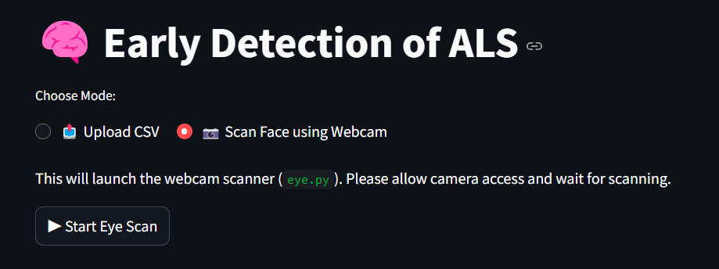
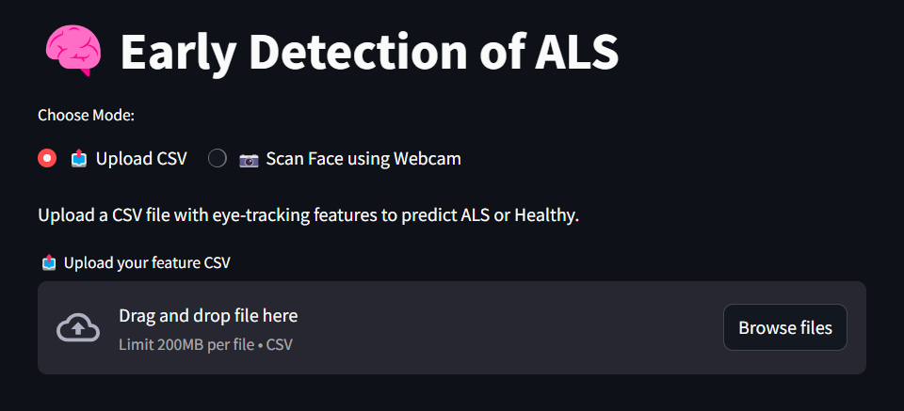
UI

Slide 18
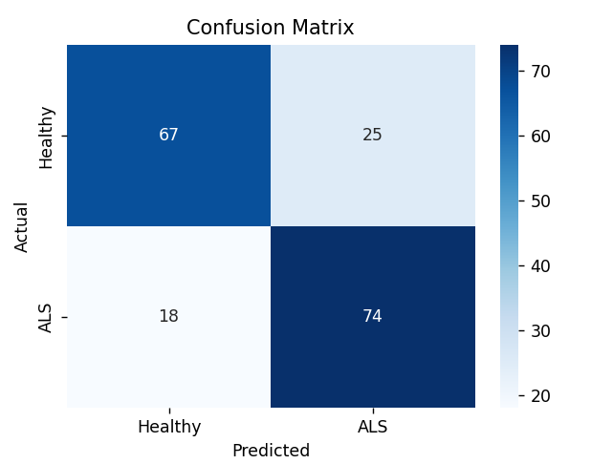
Results
Our final system was evaluated using both standard test data and real-time webcam input.
1. MLP Baseline Performance (on Test Set):
Accuracy: ~85–91%
Precision & Recall (ALS): Precision ranged from 80% to 92%, showing strong sensitivity to ALS detection.
Confusion Matrix: Most ALS cases were correctly classified, while false positives for healthy samples were minimal.
Tuned MLP (KerasTuner):
Hyperparameters (units, dropout, learning rate) were optimized using Hyperband.
The tuned model gave slightly improved generalization, especially in real-time settings.

Slide 19
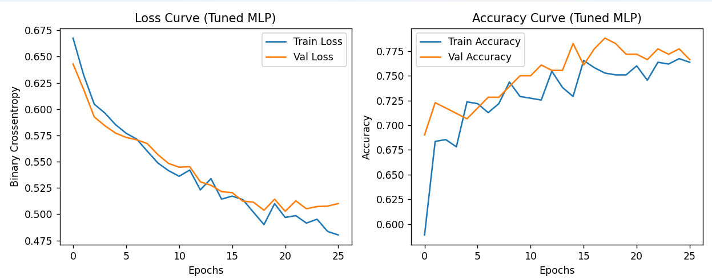
Results
2. Webcam Eye Scan Results:
Real-time session features (duration, gaze points, saccades, fixation) were computed using Mediapipe + OpenCV.
These were used to generate a temporary scanned_features.csv which was fed into the trained MLP.
The prediction was displayed immediately within the Streamlit app after scanning completed.

Slide 20
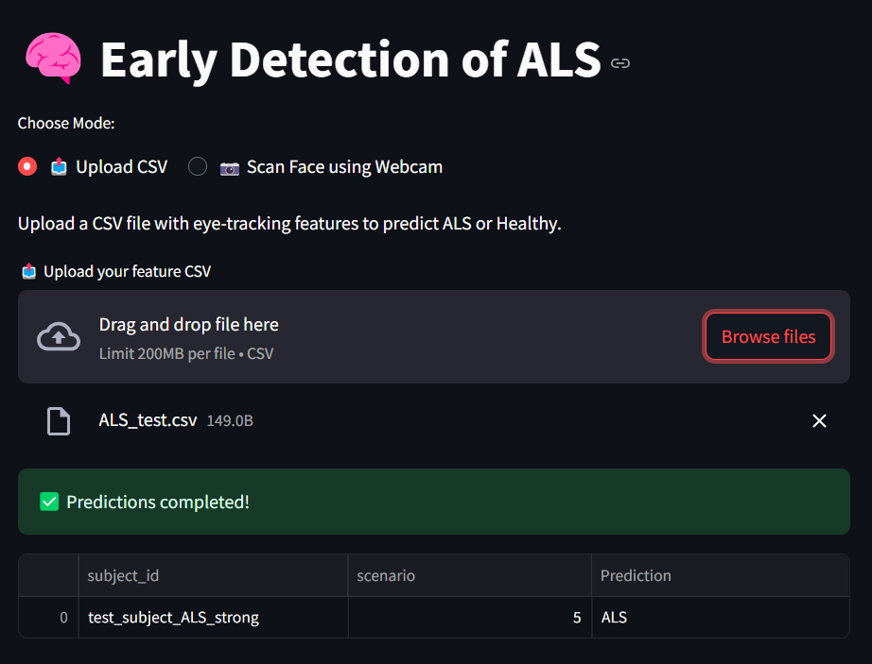
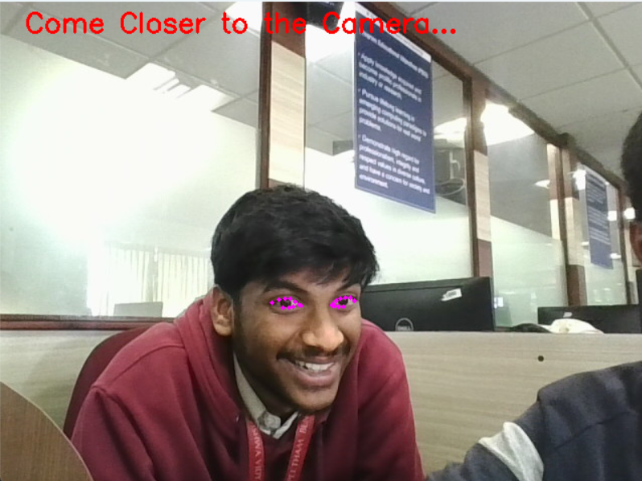
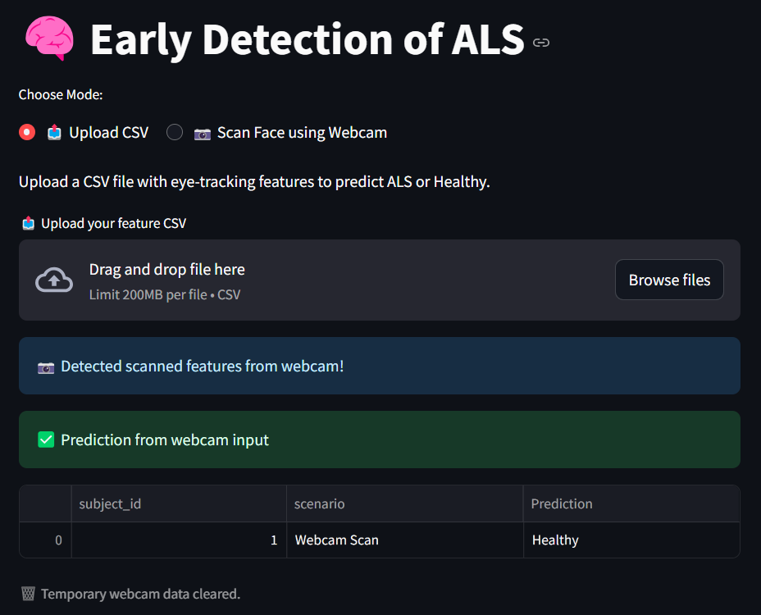
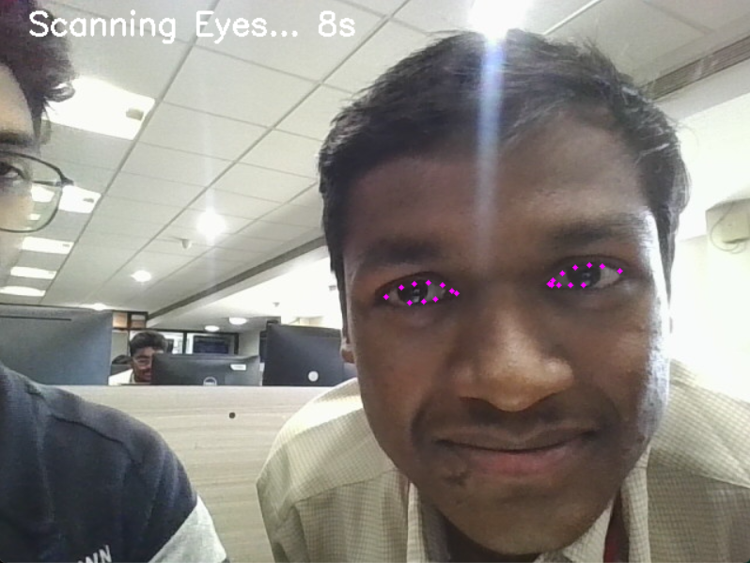
Results

Slide 21
Conclusion
Our project demonstrated a novel pipeline for early ALS detection using non-invasive eye-tracking features.
Successfully combined:
Raw gaze data preprocessing
Feature engineering of gaze dynamics
Deep learning-based classification (MLP + tuning)
Real-time webcam integration
User-friendly interface via Streamlit
Achieved strong performance even on a small, imbalanced dataset by applying effective:
Feature scaling
Undersampling
Hyperparameter tuning
End-to-end prediction flow (scan ➝ extract ➝ classify ➝ show) was seamless.

Slide 22
Future Scope
To further enhance and expand this system:
Mobile/Web Deployment: Convert the system into a lightweight Android/iOS app using TFLite or React Native with camera access.
More Robust Feature Extraction: Include pupil dilation, blink rate, and head motion tracking from webcam to improve early detection accuracy.
Clinical Dataset Integration: Collaborate with medical professionals to validate the system on real-world ALS diagnostic scenarios.

Slide 23
THANK YOU!

